Slide 1
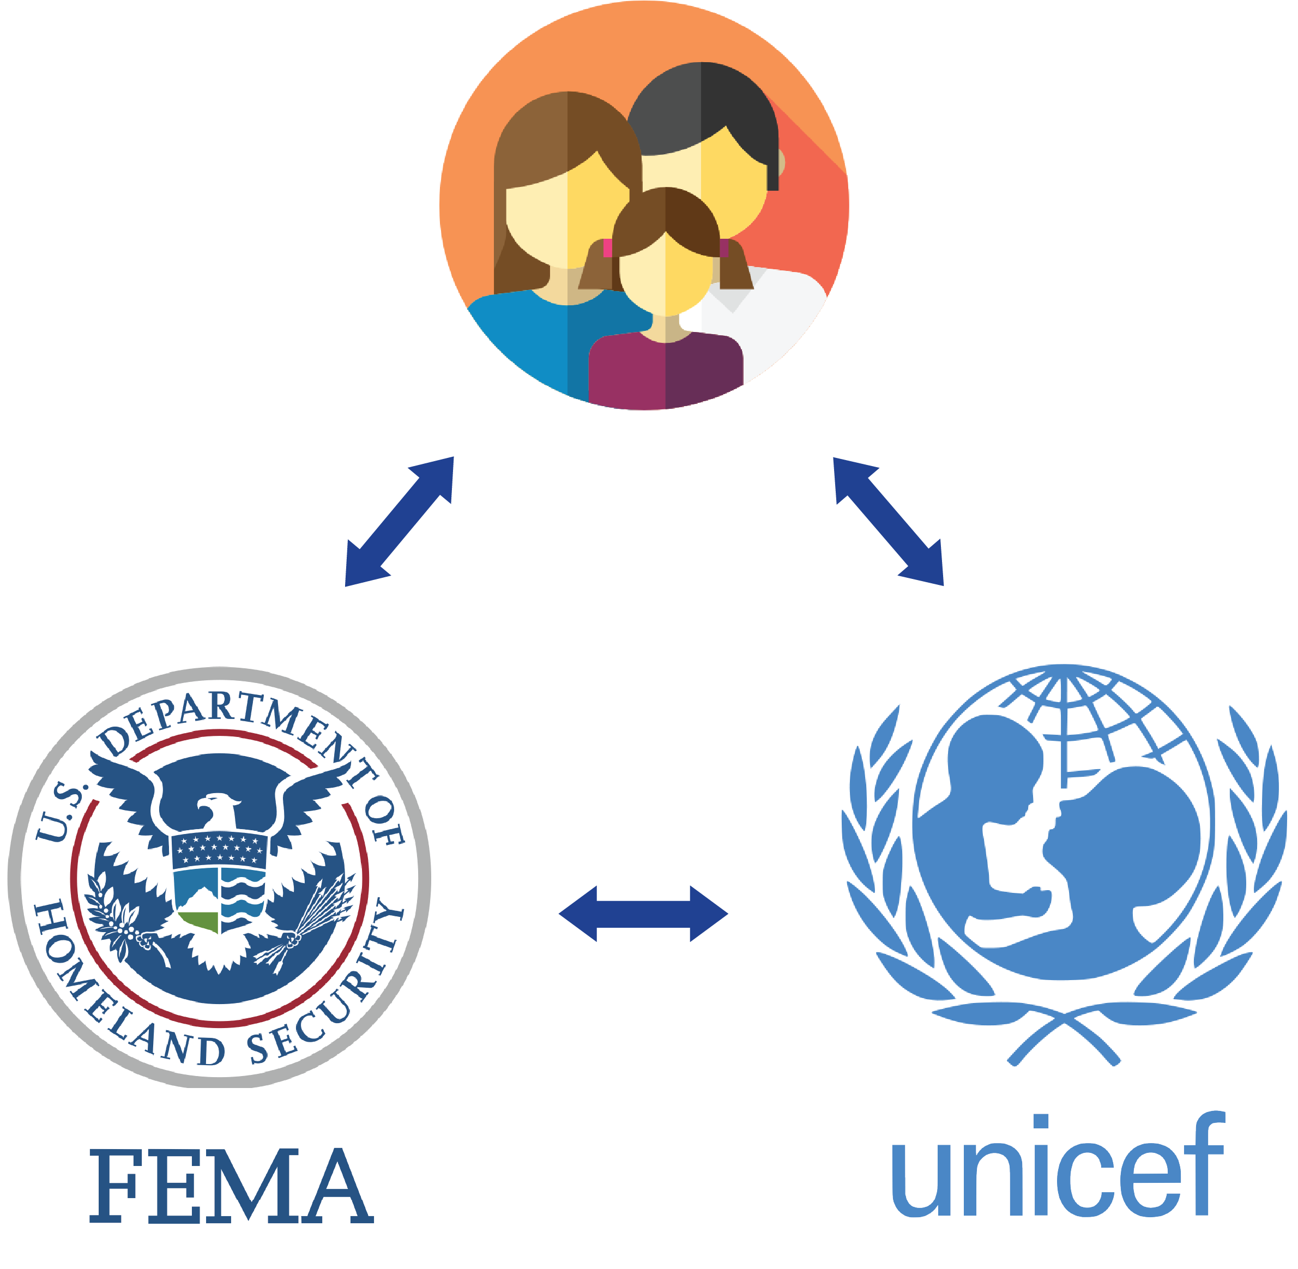



Slide 2
Private Citizens
Get Updates
Peace of Mind
Be Prepared

Slide 3
Agencies & NGOs
Reinforce evacuation orders
Identify private shelters
Heatmap of emergency supplies
Connect with citizens via SMS

Slide 4
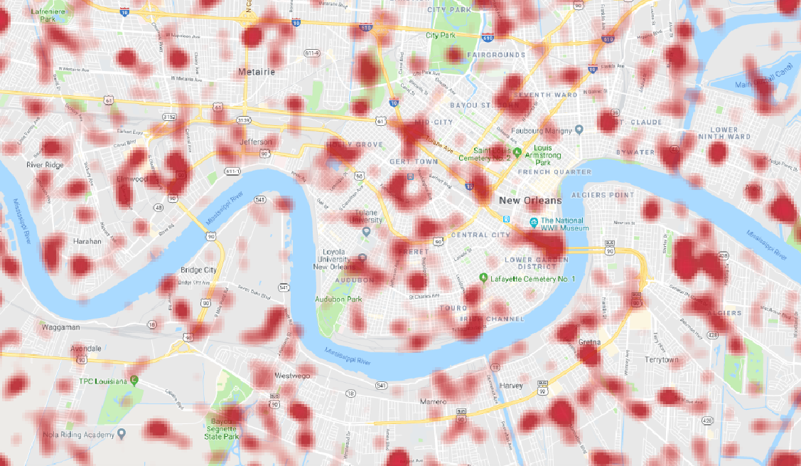
Visualize Private Shelters

Slide 5
Future Enhancements
Residents
Enable residents to document the condition of their residence before and after the disaster
Report an issue
Allow people to respond with their updates via SMS
Government
Leverage property records to predict the resilience of each house based on forecast data
Expose data about pre-storm supply levels to local retailers

